Slide 1

Waste-to-Energy - Making
Circular Economy Happen
Paul De Bruycker, CEWEP President
3rd October 2018, Lisbon
Torino WtE plant, Italy

Slide 2

The Circular Economy
  ‘Circular’ = sustainable, environmentally friendly ‘Economy’ = value creation

Slide 3
Waste management in the Circular Economy
The waste concept remains important, also within the CE
  Residues, used goods, objects without any (subjective) value for the holder should be taken care of
  Waste regulation needs to assure that those materials will not be spread in the environment and will be recovered/reused as much as possible
  => waste will also exist within the CE
The role of waste companies within the CE
  A logistic role (collect small amounts at different locations and deliver the necessary quantities to the production/treatment sites)
  Pretreatment in order to remove unwanted and/or hazardous components:
    inorganic (Hg, As, Cd,…) => treatment and safe sink
    organics => WtE
KEEP THE MATERIAL CYCLES CLEAN AND SAFE

Slide 4





The role of Waste-to-Energy in the CE
Turns non-recyclable waste in an environmentally safe way into secure energy and valuable raw materials;
Keeps the circle clean by dealing with unwanted organic components in the material cycles (act as a pollutant sink, fulfilling a hygienic task for the society).

Slide 5
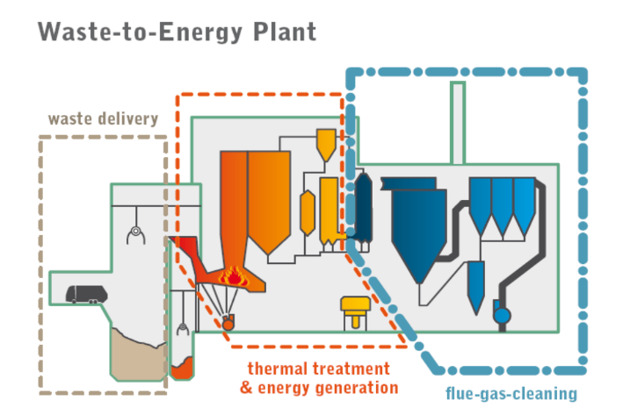
WtE acts as a pollutant sink preventing pollutants from re-entering the cycle
Sophisticated flue gas cleaning systems guarantee low emissions

Slide 6
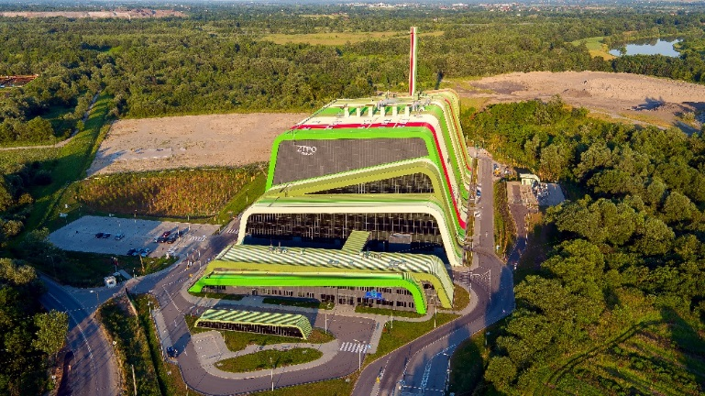


CEWEP – Confederation of European WtE Plants
Under one umbrella
CEWEP is the umbrella association of the operators of Waste-to-Energy (WtE) Plants across Europe.
They thermally treat household and similar commercial & industrial waste that remains after waste prevention, reuse and recycling and generate energy out of it.
Krakow WtE plant, Poland
2016 - CEWEP Members: 80 M tonnes; 410 plants
- Europe: 94 M tonnes; 521 plants

Slide 7
CEWEP – Confederation of European WtE Plants
Reducing dependence on landfills
Recycling and energy recovery are complementary options in order to divert waste from landfilling.
Supporting Quality Recycling
WtE prevents dirty or contaminated waste from entering the recycling chain and adversely impacting quality.
Generating value from Waste-to-Energy bottom ash
Recycling the metals and using the mineral parts in construction works to replace use of virgin materials.
Generating sustainable and reliable energy - Boosting Energy Efficiency
Use even more energy from waste in the form of heat, if the appropriate linking of heat (or process steam) customers to WtE Plants would be encouraged. The energy gains from WtE can be increased by improving access to power grids for WtE Plants.

Slide 8
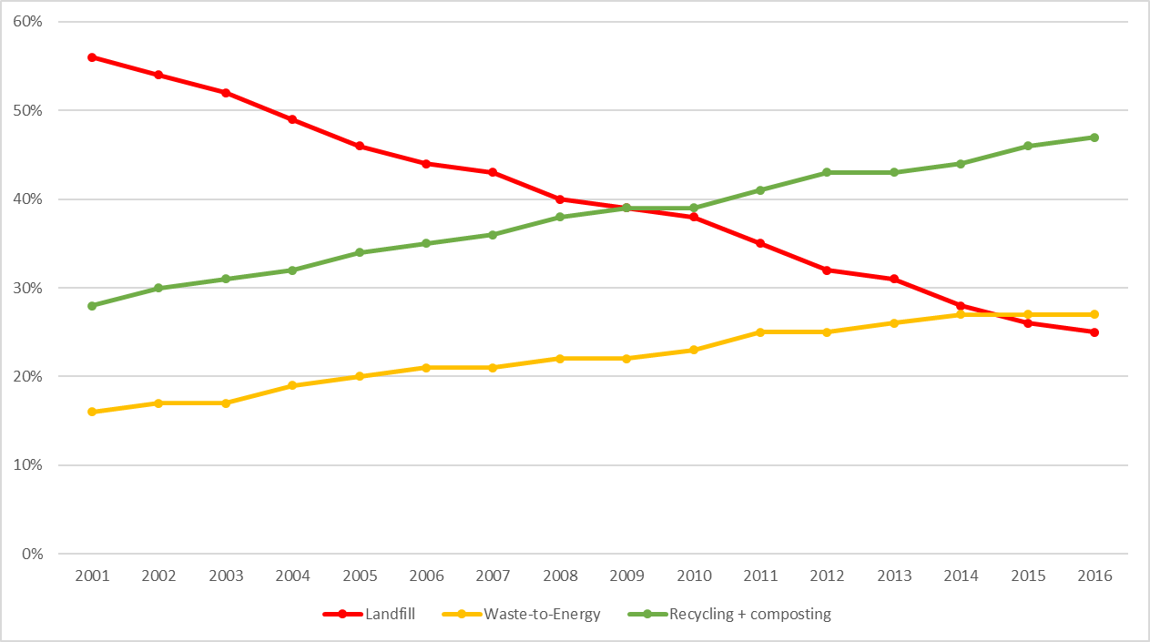

Municipal waste treatment 2001-2016 EU 28
EU 28
Landfilling -31%
Waste-to-Energy +11%
Recycling +19%
Recycling and WtE go hand in hand

Slide 9
The CE package scenario with ambitious targets for commercial waste 1/2
Add capacity slide reg. 2040, based on CEWEP board meeting 27/08/18
=> Need for W-t-E and No overcapacity at EU level
- Production residual waste in 2035 if CE package has been realised
Notes:
Assumptions:
Municipal Waste amount - 2016 - EUROSTAT
C&I Waste amount - 2014 - EUROSTAT Waste generated- Only the relevant waste streams (excluded all the mineral waste - amount of MW
TARGETS (by weight):
2035 - 65% recycling - 10% max landfilling
2030 - 60% recycling - no targets on landfilling. Assuming that the waste shift to recycling comes from landfilling for 80%
2025 - 55% recycling - no targets on landfilling. Assuming that the waste shift to recycling comes from landfilling for 80%
If countries with high landfilling in 2013 can apply derogation targets are:
2035 - 60% recycling - 25% max landfilling
2030 - 55% recycling - no cap on landfilling
2025 - 50% recycling - no cap on landfilling
These countries are: Bulgaria, Croatia, Cyprus, Estonia, Greece, Hungary, Latvia, Lithuania, Poland, Romania and Slovakia.
20% of the residues from recycling of Commercial and Industrial waste goes to landfills, 80% goes to WtE.
Residues from recycling of Municipal Waste are assumed as zero, taking into account the new definition of recycling in the legislative text.
regarding Commercial and Industrial waste:
I reintroduced almost all the non-mineral wastes, check the list (in green) under the sheet “C&I waste”
I updated the assumption form, so that you can set the recycling rate and the landfilling rate of the C&I waste. By default, you will find 80% recycling, 7% landfilling (13% WtE). Very conservative, plus 10 % residues from recycling. This don’t want to be any kind of scenario, I think we should discuss the numbers.
I added a graph on the right side of the main schemes

Slide 10
The CE package scenario with ambitious targets for commercial waste 2/2
Energy production and CO₂ savings
Energy Production scenario 2035
ktonnes waste recycled
Heat production [MWh]
Electricity production [MWh]
Add slide on energy production adn CO2 savings in 2040, based on CEWEP board meeting 27/08/18

Slide 11
The Waste-to-Energy roadmap
Making the circular economy happen;
Recycling and energy recovery are complementary options in order to divert waste from landfilling.
Keep the cycles clean, contribute to climate protection, keep our cities clean and healthy
Diverting waste from landfill helps to reduce greenhouse gas emissions, the proper treatment of non recyclables fulfils a hygienic task for society and acts as a sink.

Slide 12


Thank you for your attention
Paul De Bruycker
info@cewep.eu
Tel. +32 2 770 63 11
www.cewep.eu

